Slide 1
Introduction to Networking
Networking 101, Day 1

Slide 2
Class Objectives
By the end of today’s class, you will be able to:
Identify clients, servers, requests, and responses in network communications.
Identify network topologies and compare their advantages and disadvantages.
Design a conceptual network made of various network and network security devices.
Convert binary numeric representations into readable IP addresses.
Modify DNS host files to redirect the access of a website.
2

Slide 3
Introduction to Computer Networking
3

Slide 4

Today, we will be switching gears to focus on one of the most important topics in cybersecurity: networking.
4
Notes:
Image source: AdobeStock_192261203

Slide 5
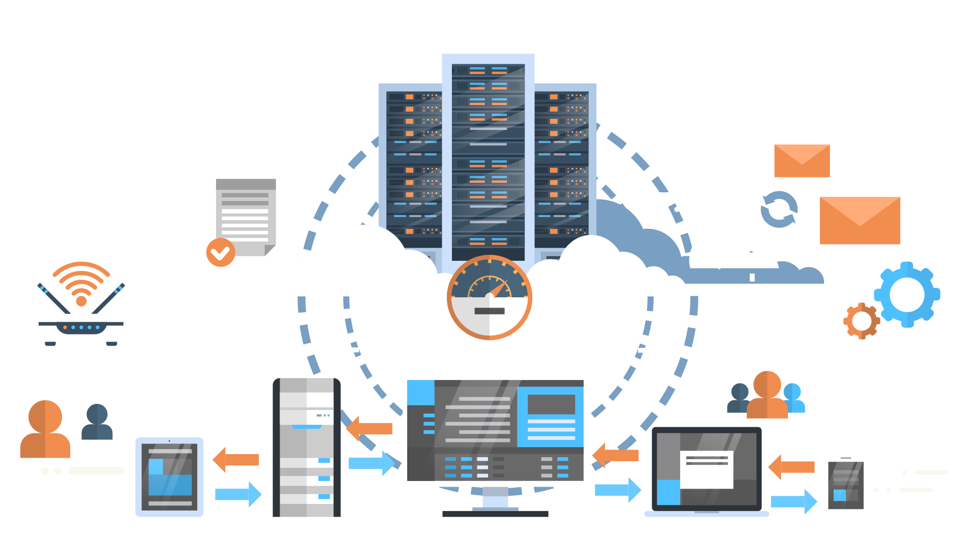
Computer Networks
A computer network consists of multiple devices connected together to share resources and services.
Resources: Web pages, email images, data files
Services: Online order processing, GPS, online gaming, video streaming
Devices (nodes): Computers, laptops, cell phones, printers, servers
5
Notes:
Image source: shutterstock_697523956

Slide 6

Computer Networking
Knowledge of computer networking is essential for the following technical roles:
Security operations center (SOC) staff commonly diagnose and troubleshoot network-related security issues and attacks. Understanding network devices and design can help them quickly resolve and identify these issues.
Network security engineers are often involved in the design of a company's network architecture to protect their organization from security risks.
Penetration testers test for vulnerabilities within a company's network. Understanding network design and common network vulnerabilities is core knowledge for penetration testers.
6
Notes:
Image source: shutterstock_1291533214

Slide 7
The Client-Server Model
7

Slide 8
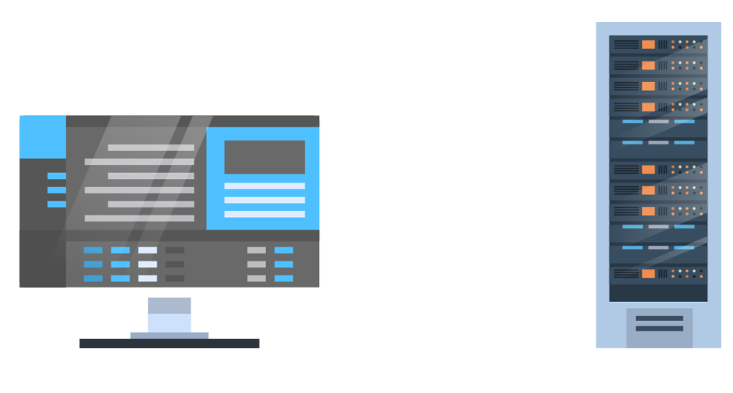
Network Communication: The Client-Server Model
The client-server model is a network computing model that defines how resources and services are shared across a network.
8
Notes:
Image source: shutterstock_697523956

Slide 9

Client-Server Model
The client is requesting a resource or a service.
The server hosts the resources and services requested by the client.
The server returns the resources or executes the service, as requested.
The client sends a request for info to the server.
Client: I’d like file X, please.
2. The server responds with data.
Server: Here’s the file X you asked for.
x
9

Slide 10
Client-Server Model
This two-way conversation between the client and server is known as the request and response method of device communication.
Request
Client: I’d like file X, please.
Response
Server: Here’s the file X you asked for.
x
10

Slide 11
Client-Server Model
01
02
03
The request is the process in which the client sends a message to a server asking for a resource or to run a service.
The response is sent back to the client after the server receives and processes the request.
The response message could be:
An acknowledgement of the request.
A requested resource.
An error message.
11

Slide 12


Client and Server Example
Let’s take the example of a webpage.
1. You want to view the vacation photos your friend posted on Facebook. When you
view them...
2. ...the browser is making a request: “Facebook, can you please get me my friend’s vacation photos?”
3. Facebook's web server provides a response: “Yes, here are your friend's vacation photos.”
Website
Facebook, can you please get me my friend’s vacation photos?
Website
Facebook, can you please get me my friend’s vacation photos?
12

Slide 13
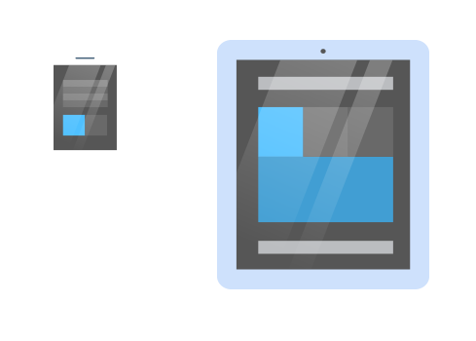
One Server, Many Clients
The client-server model is not a “one client, one server” relationship. Typically, servers receive resource requests from many clients.
13

Slide 14
Client-Server Model Continued
There’s a lot to learn about this “simple” process.
How does the client find the server and vice versa?
How is the request made?
How is it sent?
Client: I’d like file X, please.
Server: Here’s file X you asked for.
How is the file found?
How is it sent?
x
14

Slide 15
Introduction to Network Security
15

Slide 16

Networks and Security
As we cover the tools and processes within the wide scope of networking, we will also discuss threats and risks.
Network security is the practices and policies used to protect and monitor a computer network’s resources against these threats and risks.
13
Notes:
Image source: shutterstock_1095422036

Slide 17
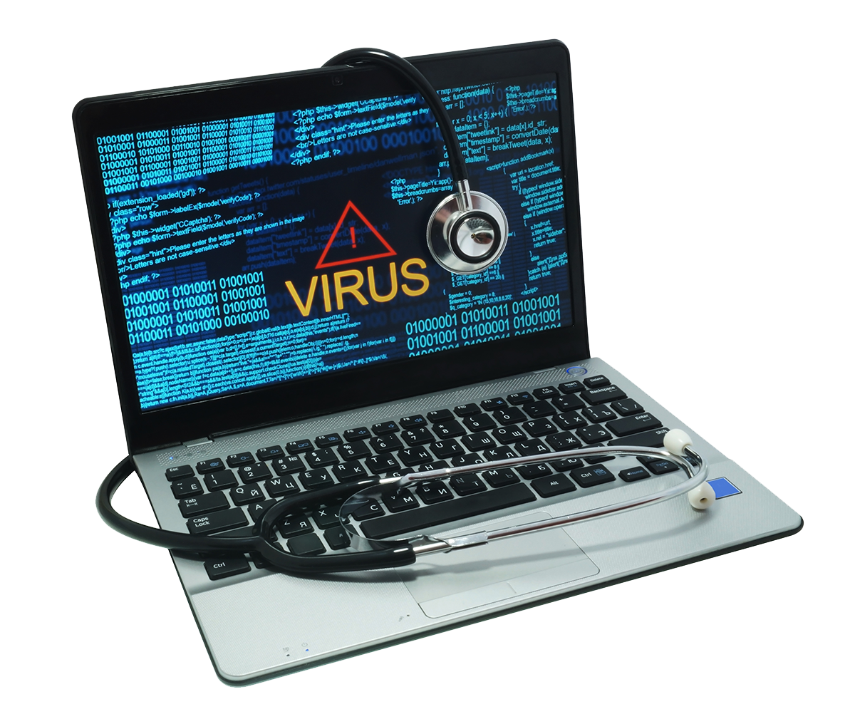
Network Security
These risks and threats include:
Unauthorized access to networks
Denial of service (DoS) attacks
Eavesdropping
Datamodifcation
17
Notes:
Image source: shutterstock_195830201

Slide 18
Activity: Network Security
In this activity, you will play the role of a security analyst at Acme Corp, which has recently experienced some suspicious activity on their systems.
10 Minutes

Slide 20
Network Structure

Slide 21

As mentioned, a computer network consists of multiple devices (nodes) connected to each other. But how exactly are they connected?
21
Notes:
Image source: Matthew Butler

Slide 22
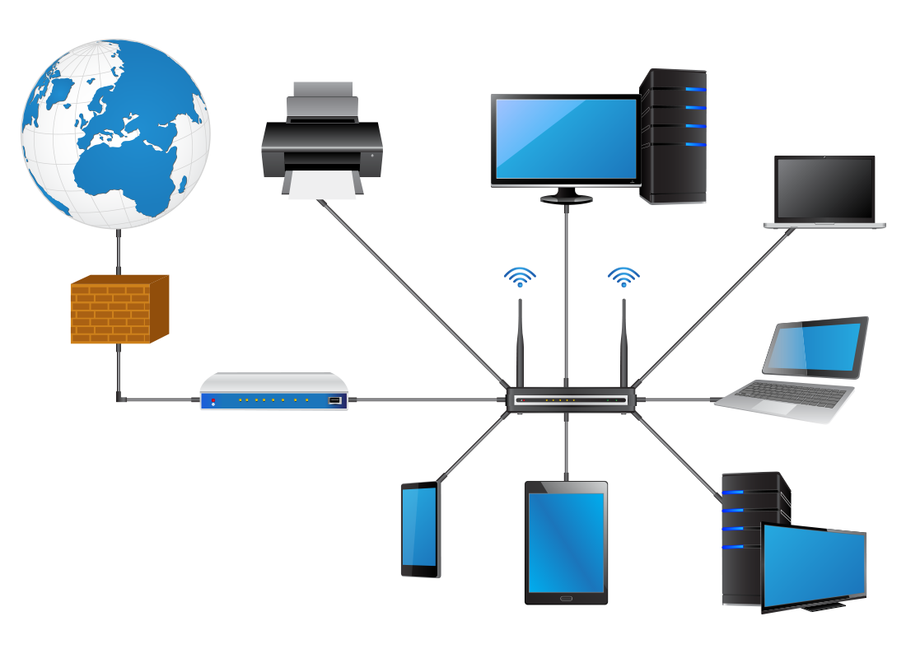
Local Area Network
When computer networks were first created, they were smaller private networks designed to connect devices within the same room or building.
This type of network is a local area network (LAN)—a private computer network that connects devices in smaller physical areas.
internet
client
printer
laptop
firewall
network router
wifi router
laptop
client
mobile phone
tablet
22
Notes:
Image source: shutterstock_138397559

Slide 23
Benefits of LANs
LANs offer the following advantages:
Network speed and performance: Since the devices are physically near each other, connections are significanly faster and perform better.
Network security: With security devices, a business can control what data comes in and out of their local network as well as who has access to resources.
Versatility: New network devices can be easily added or removed inside a LAN due to the proximity of the devices within the network.
23

Slide 24
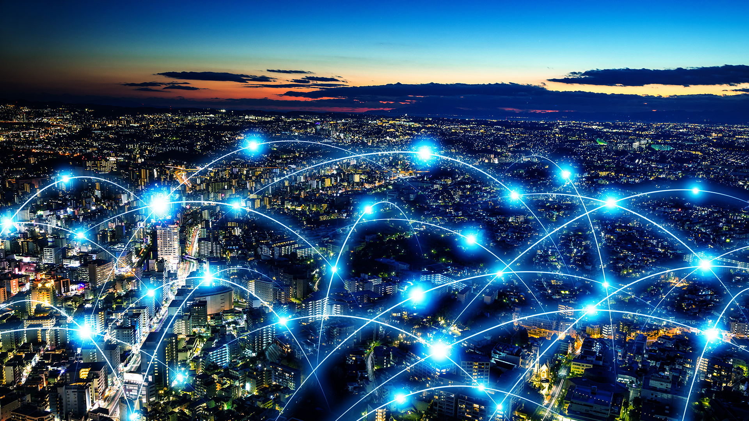
As technology advanced, computer networks expanded and small networks in different locations were able to connect, creating Wide Area Networks (WAN).
24
Notes:
Image source: shutterstock_713649202

Slide 25
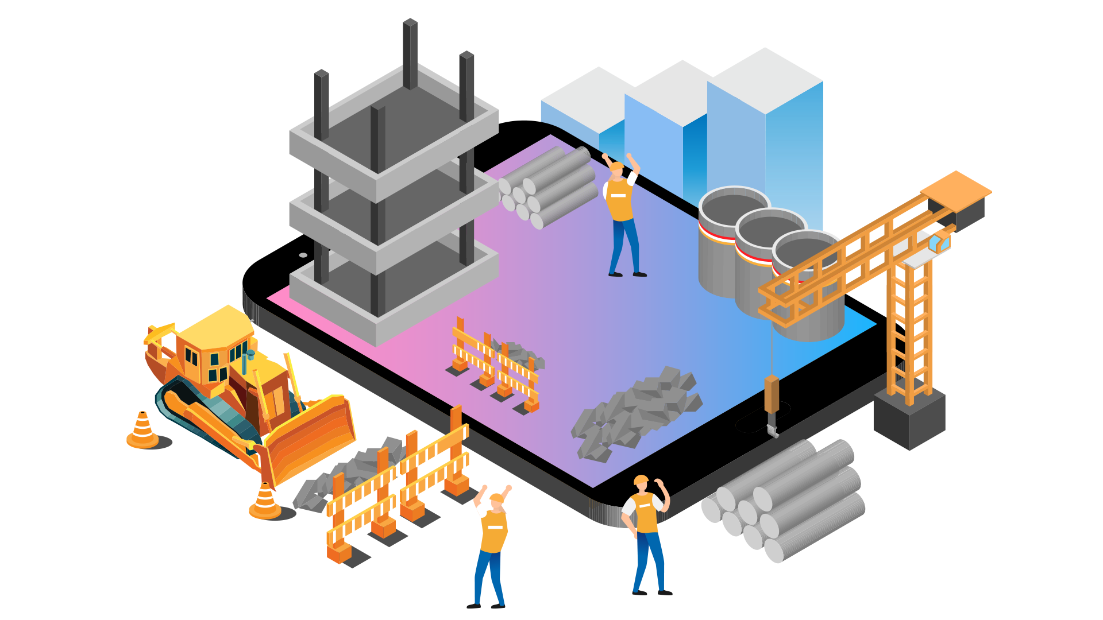
Network Topologies
Machines on a network are connected in a specific design in order to properly serve the required performance, data flow, and security factors.
There are a variety of network topologies.
These are named for the geometric shape of their design.
25
Notes:
Image source: shutterstock_1445218448

Slide 26

Network Topologies
Ring
26

Slide 27
Network Topologies
Linear
27

Slide 28
Network Topologies
Star
28

Slide 29
Network Topologies
Bus
29

Slide 30
Network Topologies
Tree
30

Slide 31
Network Topologies
Fully Connected
31

Slide 32
Network Topologies
Mesh
32

Slide 33
Network Topologies
Hybrid
33

Slide 34
Topologies and Network Security
If an attacker takes down a device that is a “point of failure,” that local area network will be impacted.
Point of Failure
Good
Good
No Connection
No Connection
34

Slide 35
Network Devices
35

Slide 36
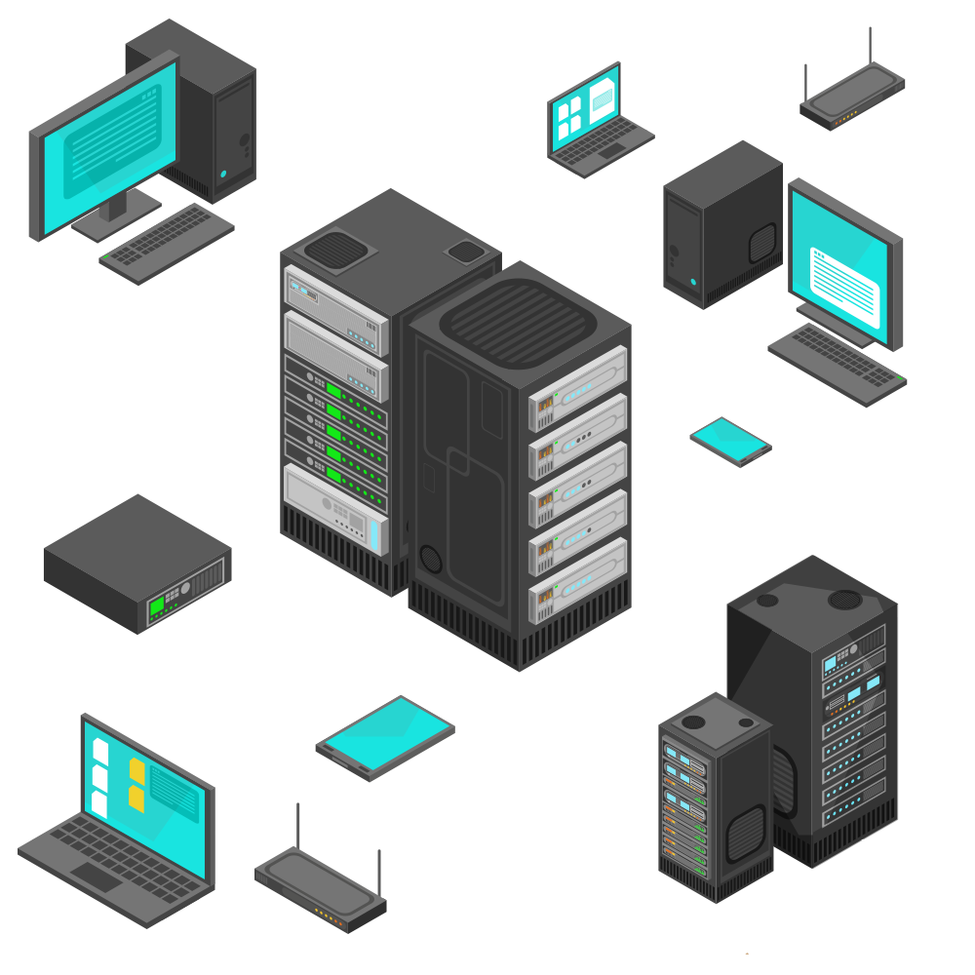
The nodes that
connect a network are actually many different devices, each with a variety of responsibilities.
36
Notes:
Image source: AdobeStock_156132408

Slide 37
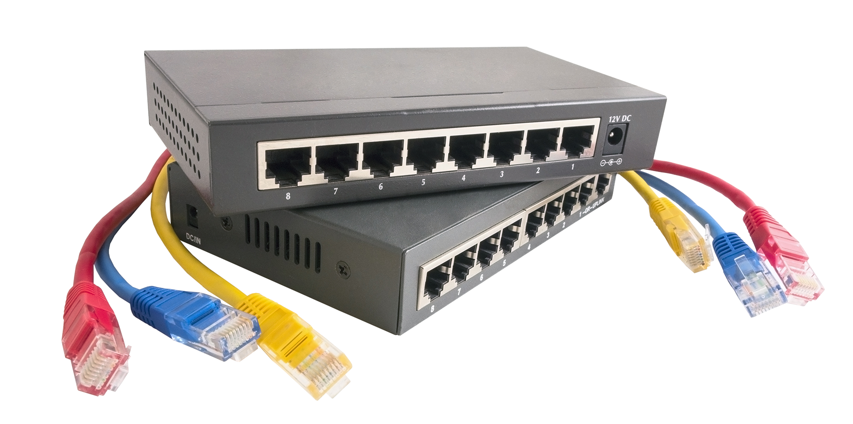

Network Devices: Router
A router is a networking device that forwards (routes) resources to other networks. A router can connect two different LANs, two different WANs, a LAN to a WAN.
Routers are commonly used to connect a home network (a LAN) to the internet (a WAN).
Router Symbol
37
Notes:
Image sources: Shutterstock_242400463 (router); shutterstock_348430685 (icon)

Slide 38
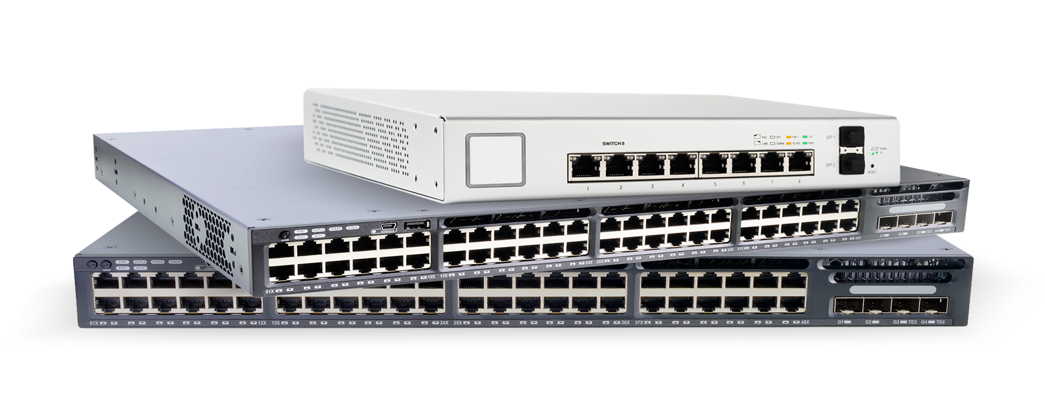

Network Devices: Switch
A switch is a networking device that forwards resources within a network. In other words, switches connect devices within a LAN.
Switches are typically used in large businesses with many computers.
Switches typically feed into routers.
Switches are intelligent devices, meaning they can be programmed to direct resources to certain computers.
Switch Symbol
38
Notes:
Image sources: AdobeStock_244465090 (top); shutterstock_264840719 (middle); shutterstock_291540545 (bottom); shutterstock_348430685 (icon)

Slide 39
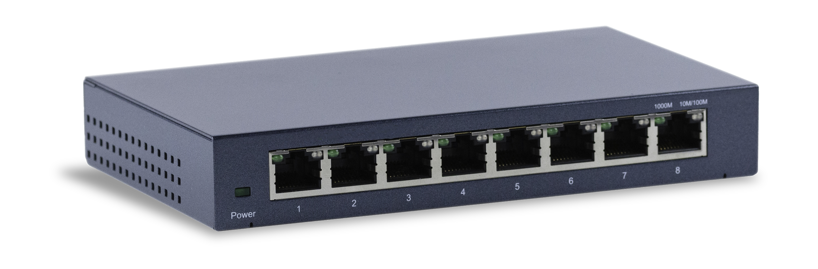

Network Devices: Hub
A hub serves the exact same purpose as a switch, except it is not an intelligent device. Therefore, hubs cannot be programmed. Instead, they will direct a copy of the exact same resource to all computers connected to them.
Hubs are less secure than switches since they direct resources to all computers, even those that do not need them.
Hubs are outdated and no longer commonly used.
Hub Symbol
39
Notes:
Image source: shutterstock_1461118808

Slide 40
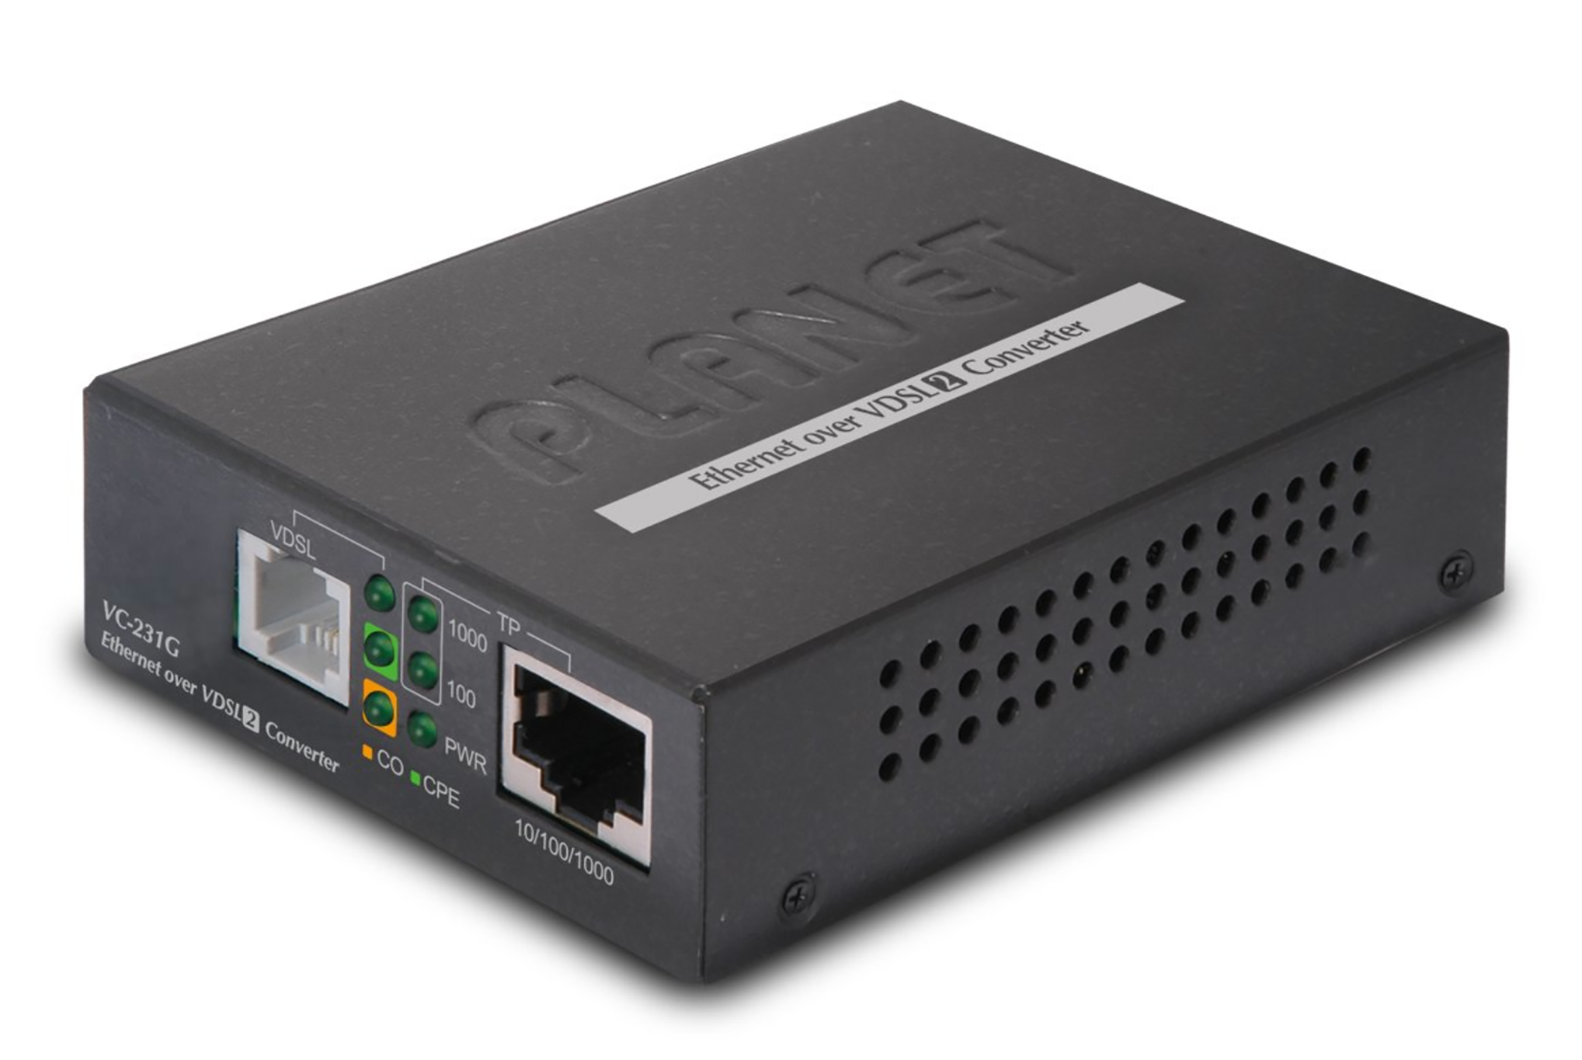

Network Devices: Bridge
Bridges are switches that only have two connections: one in and one out.
Bridges are often used to tie two LANs together.
Bridge Symbol
40
Notes:
Low-Risk

Slide 41
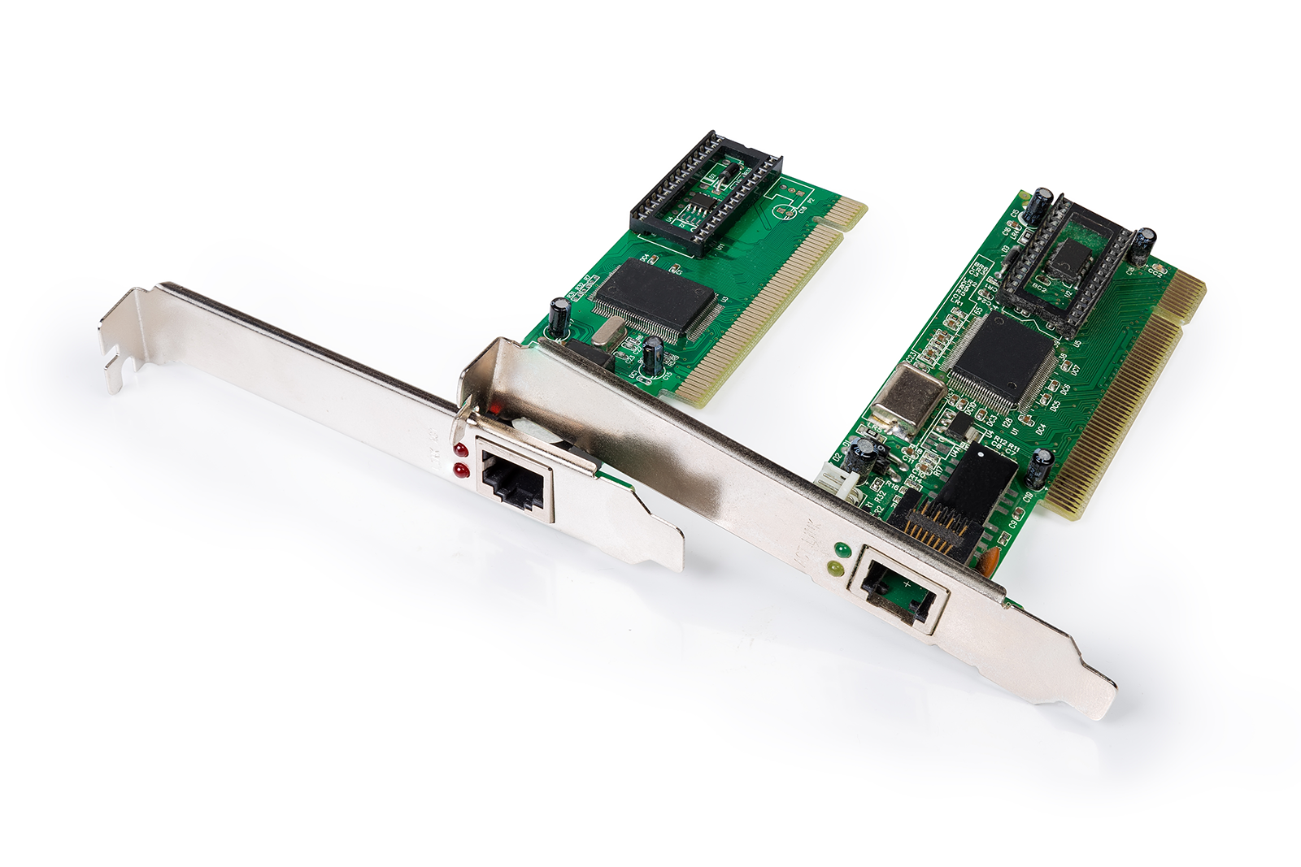
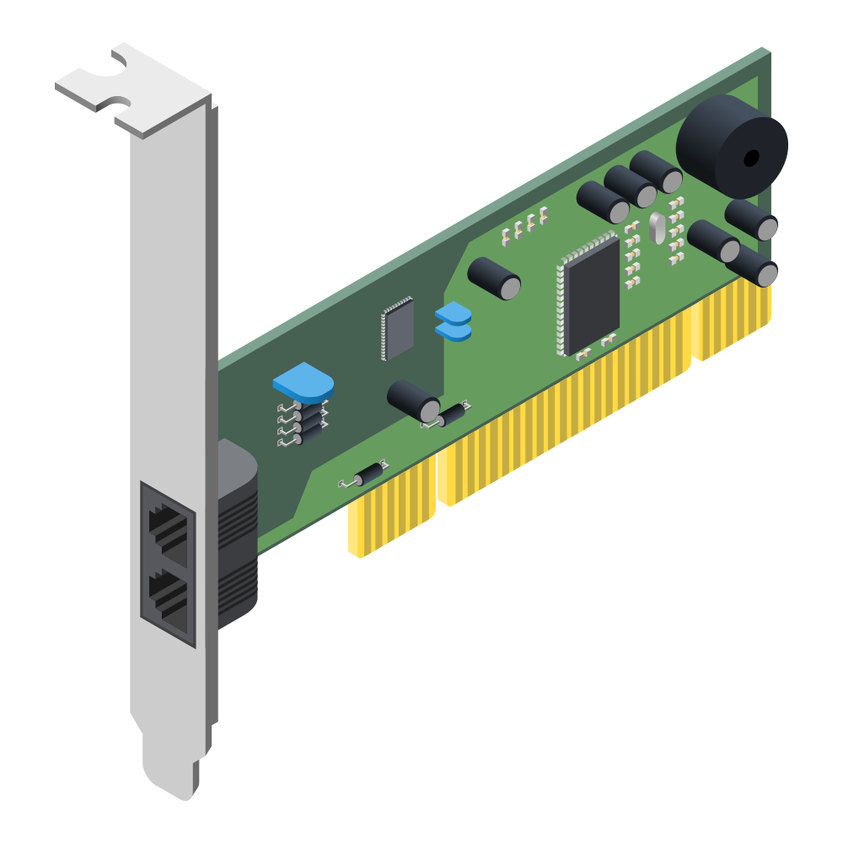

Network Devices: Network Interface Controller (NIC)
An NIC is hardware that connects a computer to a computer network.
An NIC is usually a
circuit board or chip installed on a computer.
Each computer must have an NIC in order to receive or send resources.
NICs can be wired or wireless.
NIC Symbol
41
Notes:
Shutterstock_1322349632
shutterstock_200530805

Slide 42
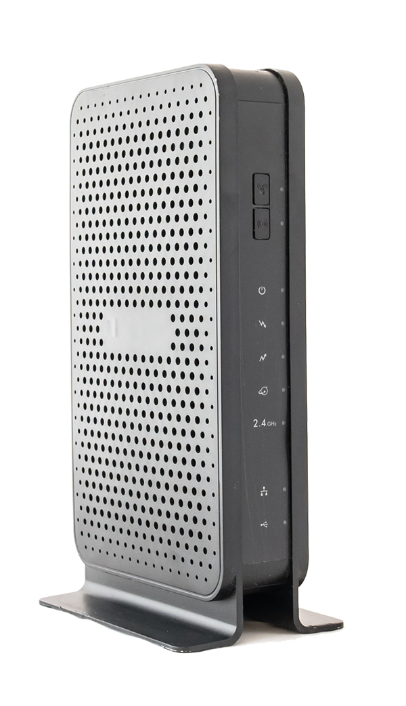
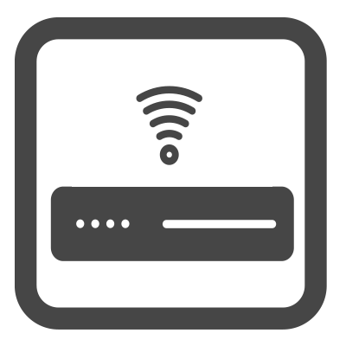
Network Devices: Modem
Modems (modulator-demodulator) converts resource data into a format that the next type of connection can understand.
In simple terms: your computer and your internet service provider speak different languages, and the modem acts as the translator.
Your computer speaks "digital" and your ISP speaks "analog."
A modem translates between your computer and the ISP so they can understand each other.
Modem Symbol
42
Notes:
Shutterstock 1126778270

Slide 43
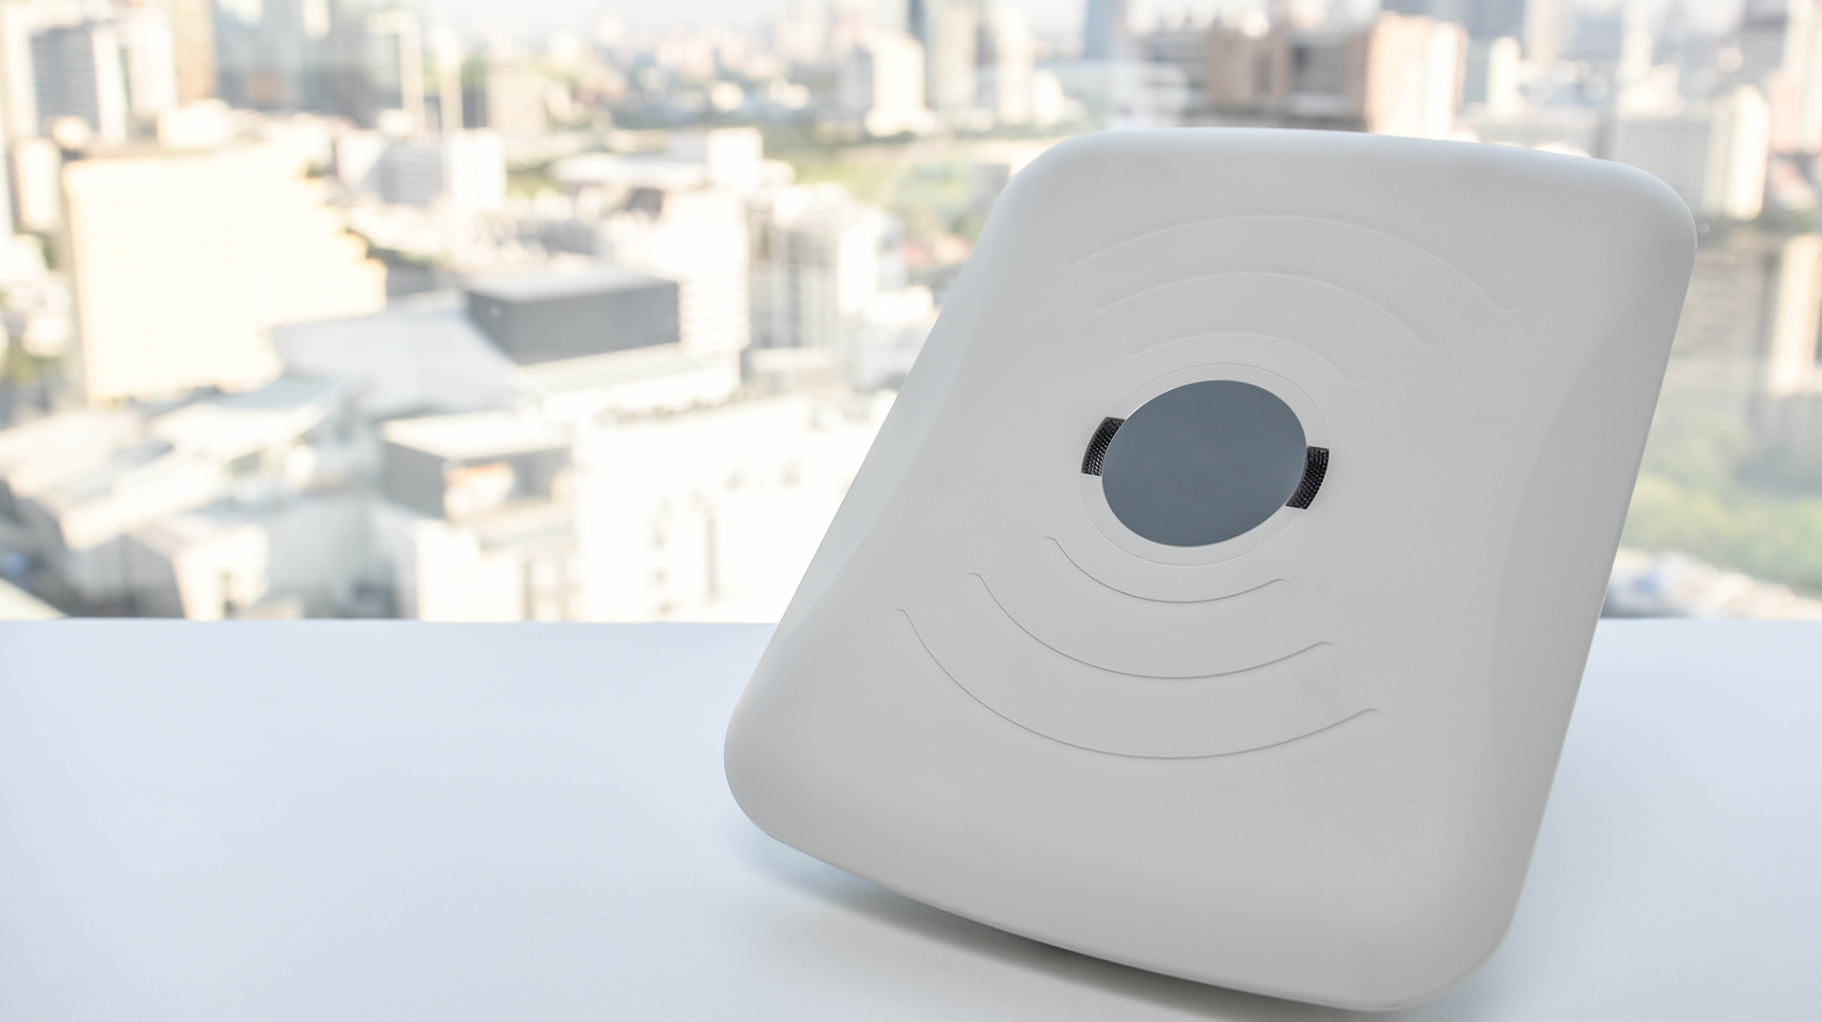

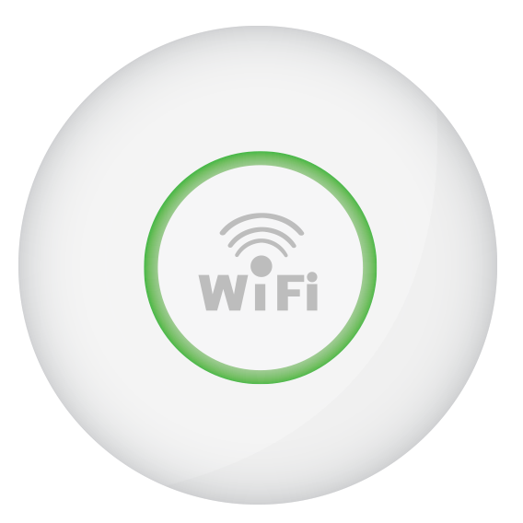
Network Devices: Wireless Access Point (WAP)
WAPs allow wireless devices to connect to a wired network.
43
Notes:
Image sources: AdobeStock_125144364 (wifi disc); AdobeStock_103926213 (background)

Slide 44
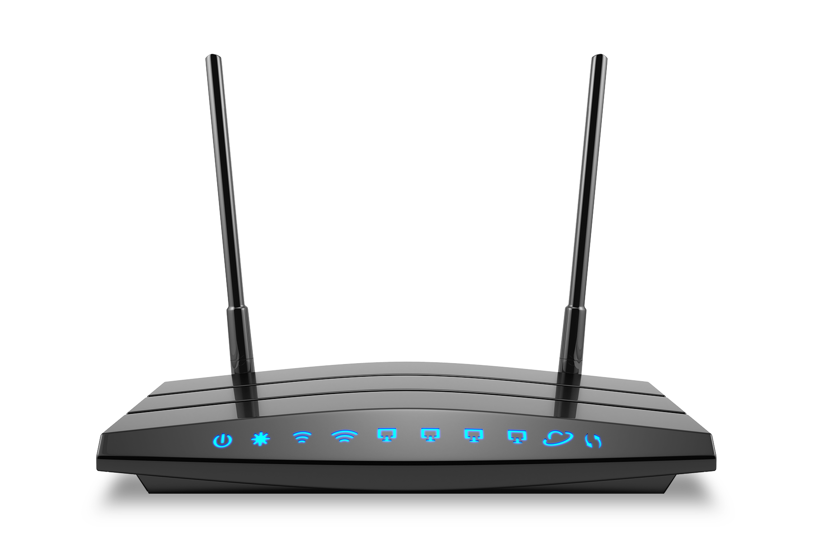
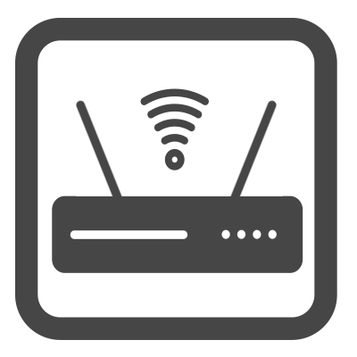
Network Devices: All-in-One Device
All-in-one devices can have modems, WAPs, routers, and more all built into a single device. All-in-one devices are very common household devices.
The advantage of all-in-one devices is ease of use, as less equipment needs to be set up and maintained.
The disadvantage is that they’re a single point of failure, and difficult to troubleshoot.
Router Symbol
44
Notes:
Image source: Shutterstock_447377149

Slide 45
The previous devices work to transfer data across networks.
There are also network security devices used to protect resources on the network.
45

Slide 46
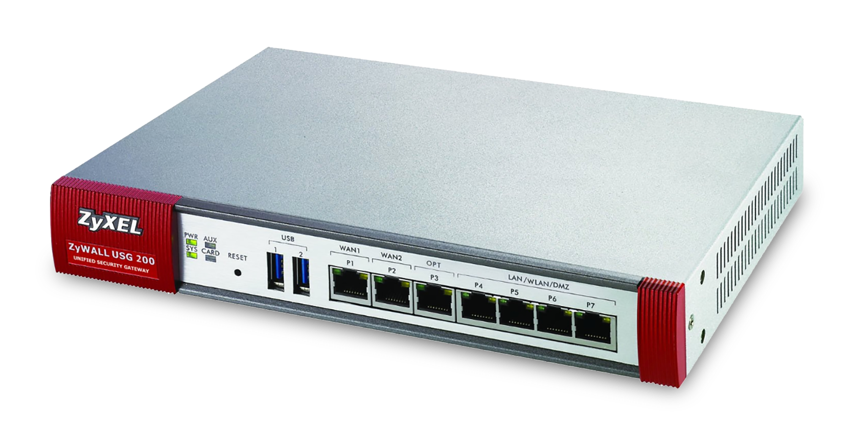

Network Security Devices: Firewall
A firewall is an intelligent network security device that monitors incoming and outgoing traffic based on security rules.
Firewalls are typically placed at the entry point of a LAN. This protects the resources inside.
There are many types of firewalls and specific firewall functionalities— these will be covered In future lessons.
Firewall Symbol
46
Notes:
Low-risk ZyXEL brand

Slide 47
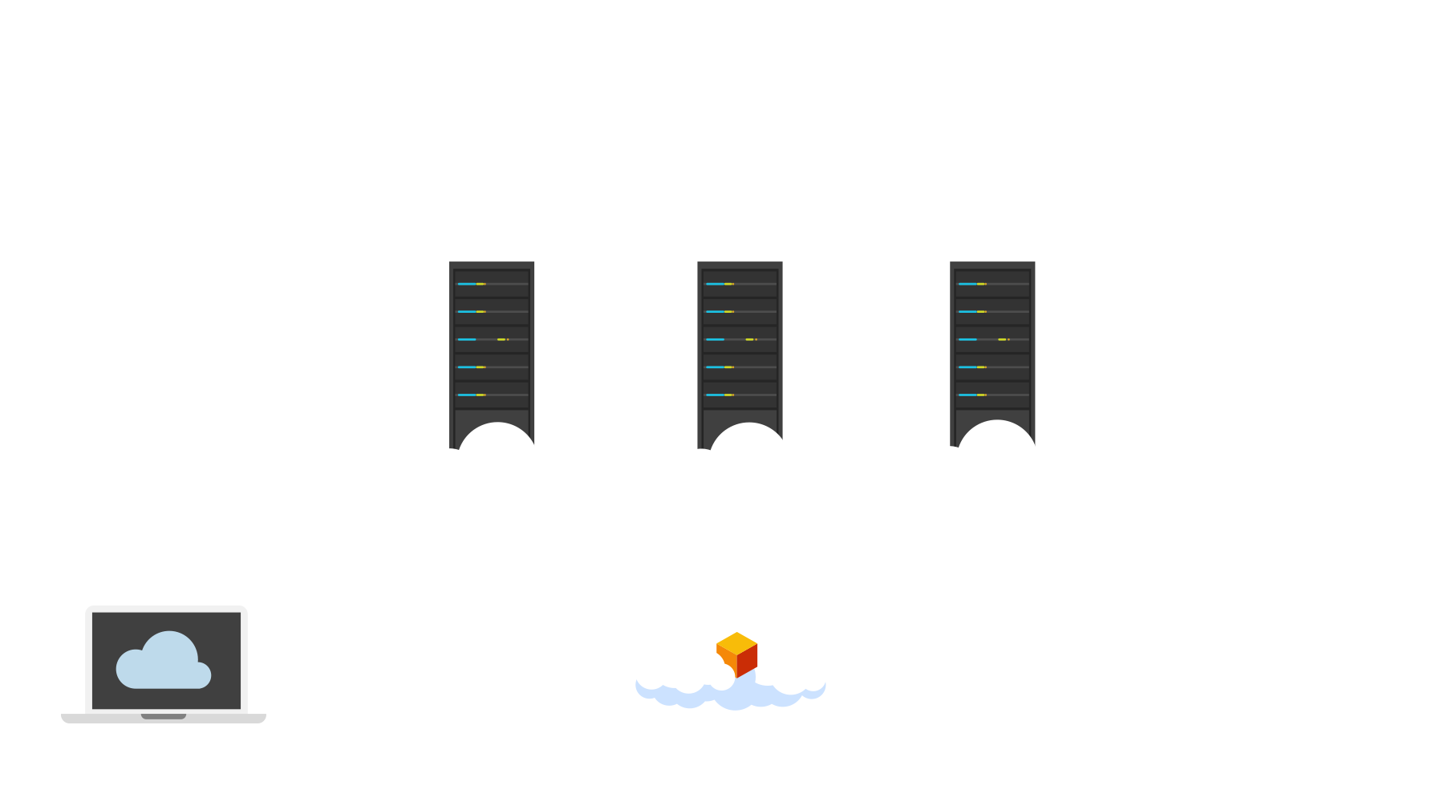
Network Security Devices: Load Balancers
A load balancer is an intelligent network security device that distributes incoming network traffic across multiple servers.
A load balancer ensures no single server has too much traffic to handle.
Load balancers help protect the availability of resources.
For example: If a server receives more resource requests than it can handle, it may go down or fail to handle a resource request.
47
Notes:
Image source: shutterstock_1032652768

Slide 48


Network Security Devices: Demilitarized Zones (DMZ)
A DMZ is a smaller subnetwork within a LAN used to add an additional layer of security to an organization's LAN, protecting secure data within the internal networks.
A DMZ typically has its own network security devices, such as firewalls, that attempt to detect network attacks before they access the internal networks.
48
Notes:
Image source: shutterstock_402312850

Slide 49


A common task for network and security professionals is to visually design a setup before purchasing, installing, and configuring a network with these devices.
49
Notes:
Image source: AdobeStock_280707008

Slide 50
Network Design Demo
Designing your network visually can assist with the following:
Making networks more efficient, since proximity of certain devices can reduce latency.
Avoiding the creation of a "single point of failure."
Ensuring private resources are protected from unauthorized sources.
50

Slide 51
Network Design Demo
In the next demo, we will use the free web tool Gliffy to design a basic network incorporating the following devices:
2 Computers
1 Switch
1 Router
1 Firewall
1 Representation of the internet
51

Slide 52
Gliffy
52

Slide 53
Activity: Network Devices
In this activity, you will continue to play the role of a security analyst at Acme Corp. You will design a network layout for the Shanghai office using Gliffy.
You will also need to add network security devices to the design to protect against a network attack.
20 Minutes
53

Slide 55

55
Notes:
Image source: AdobeStock_56885471

Slide 56
“What’s My Address?”
Binary Data and IP Addresses
56

Slide 57

Everything we see on our computer (words, numbers, images, videos, music) is, in their raw form,
binary data.
57
Notes:
Image source: shutterstock_331435670

Slide 58

Binary Data
At the most basic level, computers communicate with electric signals, which have two states: on and off.
Binary is the two-digit numerical system that indicates if a signal is on or off.
Visualized, these on and off signals are depicted as ones and zeros.
1 = On
0 = Off
Meaning is created through the specific and repeated triggering of these on and off signals. This binary data is eventually transformed into the data we see on our devices.
58
Notes:
Image source: AdobeStock_136836138

Slide 59
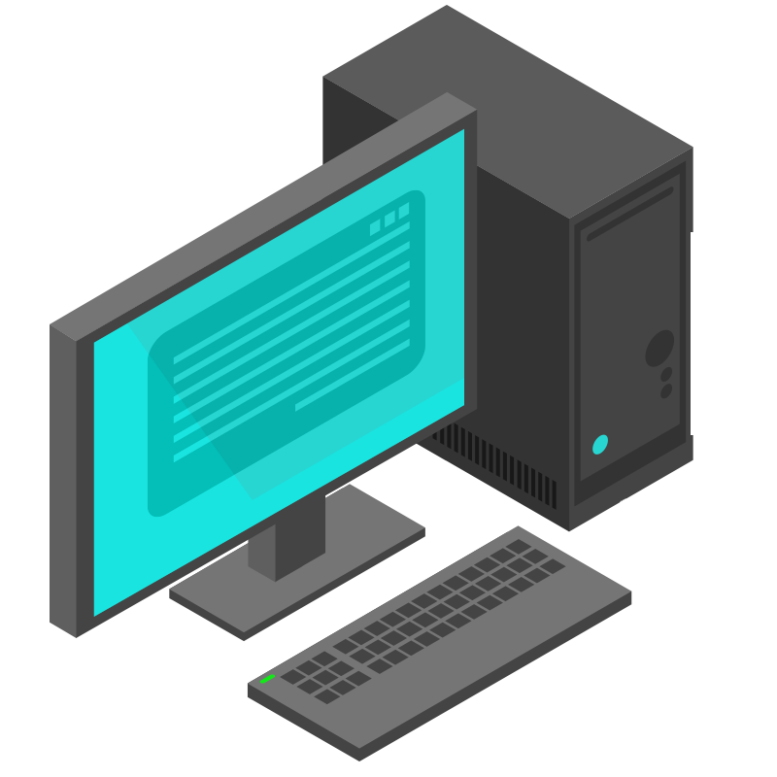
Binary Data
Our computer wants to transmit 1 2 3 4 5.
It would transmit this message using binary data:
1 = 00000001
2 = 00000010
3 = 00000011
4 = 00000100
5 = 00000101
This data would then be converted into the human-readable string: 1 2 3 4 5.
59
Notes:
Image source: AdobeStock_156132408

Slide 60
Binary vs. ASCII vs. Decimal vs. Hexadecimal
Binary is one of many alphanumeric representations of data. A few others:
Binary Two-digit numerical system using 0 and 1.
01000001 00101100 00100000 01000010 00101100 00100000 01000011 00101110 00001010 01001001 01110100 10000000 011001 01110011 00100000 01100101 01100001 01110011 01111001 00100000 01100001 01110011 00100000 00001010 00110001 00101100 00100000 00110010 00101100 00100000 00110011 00100001 00100000 00001010
Decimal Ten-digit numerical system using 0–9.
65 44 32 66 44 32 67 46 10 73 116 8217 115 32 101 97 115 121 32 97 115 32 10 49 44 32 50 44 32 51 33 32 10
Hexadecimal Sixteen-digit alphanumerical system.
41 2c 20 42 2c 20 43 2e 0a 49 74 2019 73 20 65 61 73 79 20 61 73 20 0a 31 2c 20 32 2c 20 33 21 20 0a
ASCII All the numbers, letters, and special symbols we are familiar with.
A, B, C.
It’s easy as
1, 2, 3!
60

Slide 61
Binary data is used for indicating the network addresses that machines need to direct and deliver data across networks.
61

Slide 62
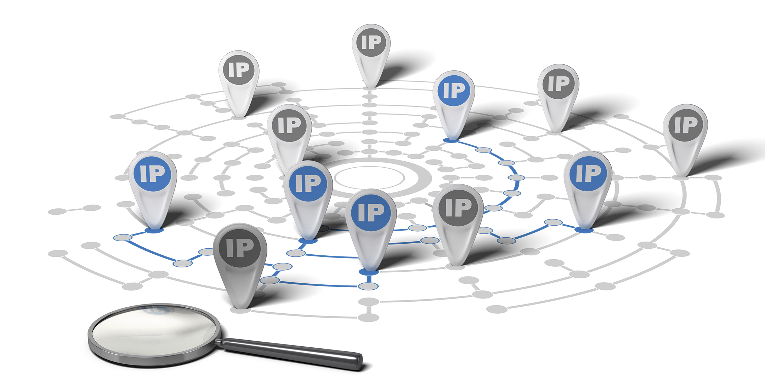
Binary and Network Addresses
Today, we’ll focus on IP addresses.
IP addresses are numerical network addresses associated with a specific device.
62
Notes:
Image source: AdobeStock_91904037

Slide 63
Each of our computers has an IP address. Let’s check them at: www.whatsmyip.org.
63
Notes:
Image source: Brent Clouse

Slide 64
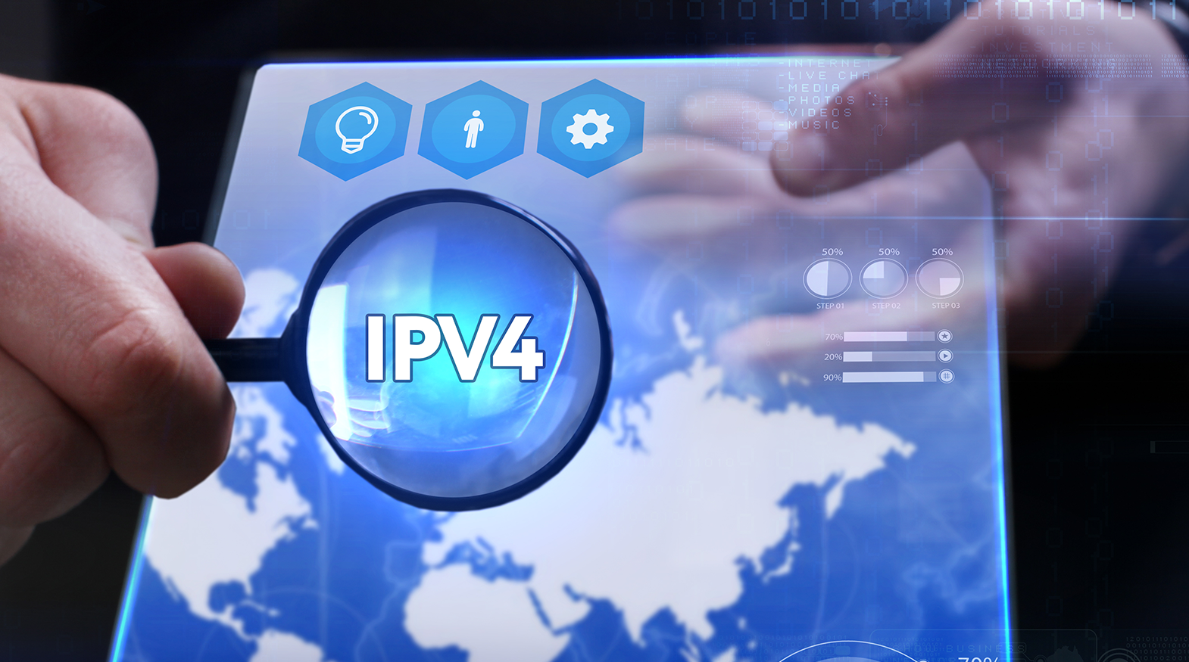

Two primary versions
of IP addresses
Are distributed.
We’ll focus on the main version, IPv4.
64
Notes:
Image source: shutterstock_580731163

Slide 65
The Anatomy of an IP Address
IPv4 IP addresses are written as four octets separated by decimals.
These octets are actually eight binary bits of ones and zeros that are converted to a more interpretable decimal form.
10.0.3.254
00001010
00000000
00000011
11111110
One byte
One bit
Eight bits = one byte
65

Slide 66

IP Example
10.0.3.254
00001010
00000000
00000011
11111110
What computers read: 00001010.00000000.00000011.11111110
What we read: 10.0.3.254
Notes:
Images source: shutterstock_697523956

Slide 67
Each IP octet can range from zero (00000000) to 255 (11111111).
67

Slide 68

Converting IP
Converting IP addresses can be tricky. Lucky for us, there are free online tools to simplify the process.
IP to Binary browserling.com/tools/ip-to-bin
Binary to IP browserling.com/tools/bin-to-ip
68
Notes:
Image source: shutterstock_523613047

Slide 69
IP addresses are categorized as public or private.
69

Slide 70

Public IPs
01
Public IP addresses are addresses that can be accessed over the internet.
02
Public IP addresses are typically assigned out in IP ranges by an Internet Service Provider.
Advantages: Public IPs’ resources are accessible over the internet.
Disadvantages: Not all devices should be accessed over the internet, as this potentially exposes these devices to malicious actors.
IP ranges are groups of IP addresses in which the numbers are typically sequential.
For example, the IP range 108.0.0.1–108.0.0.3 includes:
108.0.0.1
108.0.0.2
108.0.0.3
70

Slide 71
Private IPs
Private IP addresses are addresses that are not exposed to the internet. Instead, they are typically located within a LAN.
01
Advantages
02
Disadvantages
Private IP addresses aren't publicly accessible, and therefore more secure.
Private IPs can be reused, as long as they are in different LANs, since they can't conflict across different networks.
Private IPs are not directly accessible over the public internet.
Private IPs are assigned by a network administrator of the LAN they belong to.
71

Slide 72
Private IPs
Three IPv4 ranges are saved as private IP addresses and used only for private addressing.
Starting IP | Ending IP | IP Addresses Available
10.0.0.0 | 10.255.255.255 | 16,777,216
172.16.0.0 | 172.31.255.255 | 1,048,576
192.168.0.0 | 192.168.255.255 | 65,536
72

Slide 73
Subnetting
73

Slide 74
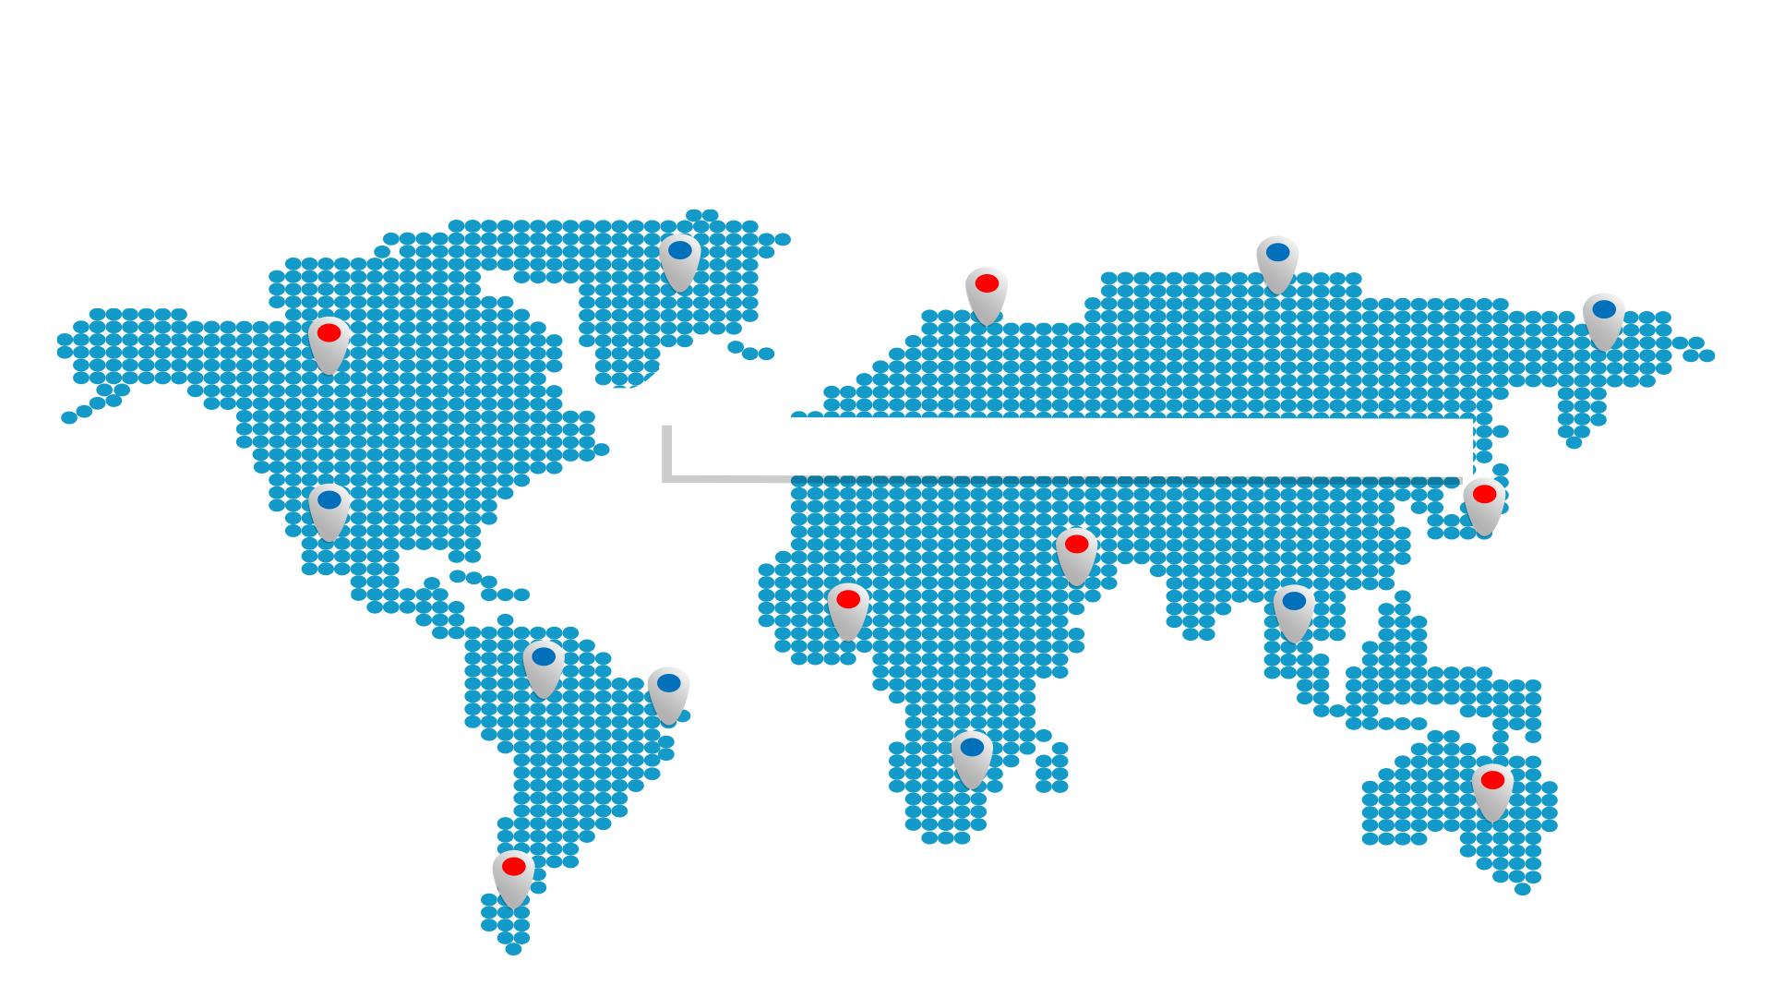
IP addresses are assigned
manually by the user or organization that manages their local network.
But how do organizations decide what IP addresses are assigned?
IP ADDRESSES
74
Notes:
Image source: shutterstock_787565869

Slide 75
Subnetting
Organizations will often group their devices together on a network for organizational and efficiency reasons. For example:
An organization would group together servers designated for Finance, and servers designated for Marketing.
Organizations are typically provided a range of IP addresses that they will distribute across departments and devices.
75
Notes:
Image sources: shutterstock_697523956 and AdobeStock_156132408

Slide 76

Subnetting
This process of breaking up an IP address range into smaller, more specific networks of grouped devices is called subnetting.
For example: If a company has 100 new IP addresses to distribute, they can assign 50 to the Finance department and 50 to the Marketing department by subnetting their provided IP range.
76
Notes:
Image source: AdobeStock_26627633

Slide 77
When we subnet, we don’t have to list and assign IP addresses one by one. Instead, we use a format known as Classless Inter-Domain Routing (CIDR).
77

Slide 78
CIDRs
CIDRs are made up of two sets of numbers: An IP address (the prefix) and a range of available IP addresses (the suffix).
192.243.3.0 /24
Prefix:
An IP address.
Suffix:
The range of IP addresses available.
24 means everything after the first 24 bits is variable.
78

Slide 79
CIDRs
CIDRs are made up of two sets of numbers: An IP address and a range of available IP addresses.
192.243.3.0 /24
32 bits
24 means the first 24 bits (three octets) are static.
8 bits
8 bits
8 bits
8 bits
79

Slide 80
CIDRs
CIDRs are comprised of two sets of numbers: An IP address and a range of IP addresses available.
192.243.3.0 /24
32 bits
24 means the first 24 bits (three octets) are static.
The last 8 bits (.0) is variable.
The range of each octet is 0–255.
There are 256 available IP addresses in the range 192.243.3.0/24.
8 bits
8 bits
8 bits
8 bits
80

Slide 81
Range Calculator
We can use online tools to easily calculate an IP address range.
CIDR-IP Range Calculator ipaddressguide.com/cidr
81
Notes:
Image source: shutterstock_523613047

Slide 82
MAC Address
Another important network address utilized within a LAN is the Media Access Control Address (MAC address).
MAC addresses are connected to network adapters on a computer and can’t be changed.
A MAC address is a string of six sets of alphanumeric characters, separated by colons.
MAC addresses can also indicate the manufacturer of the network device.
Example: 00:0a:95:9d:68:16
82

Slide 83
Activity: Network Addressing
In this activity, you will continue to play the role of a security analyst at Acme Corp.
You must convert binary traffic into an IP address, determine if it is public or private, and compare the IP to a list of Acme’s servers to see which systems the hacker is trying to access.
15 Minutes
83

Slide 85
Addresses and the Internet
85

Slide 86
Now we will look at how accessing data from the internet applies similar network addressing concepts.
86

Slide 87
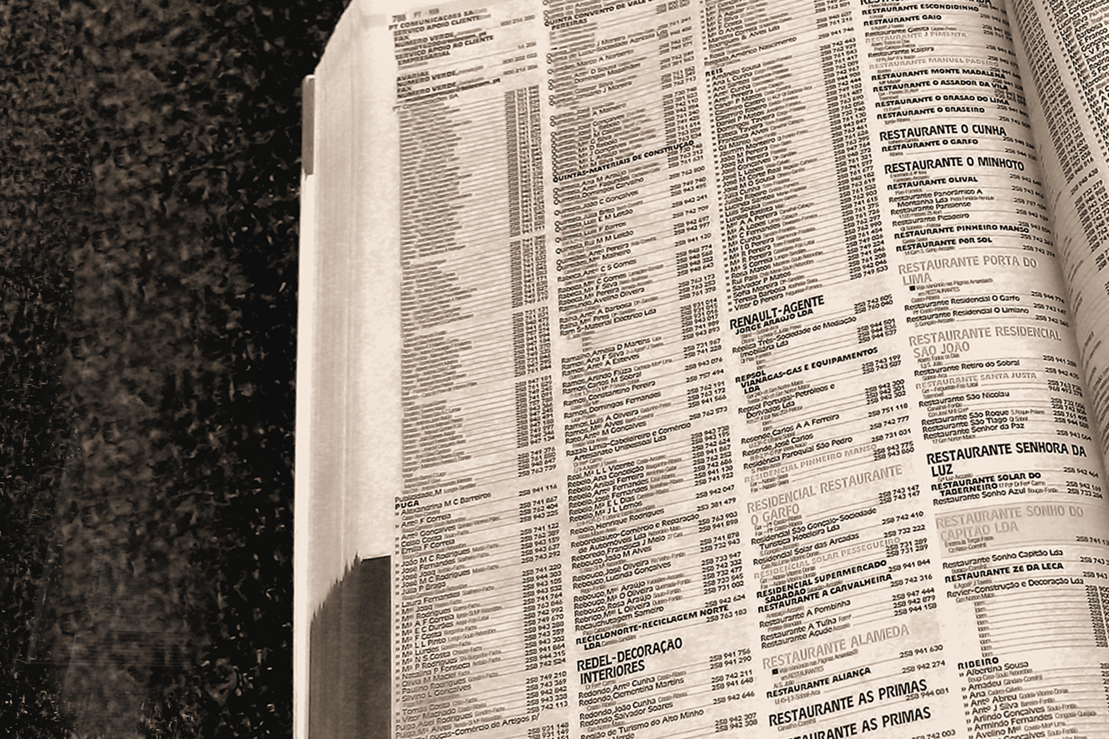
Domain Name System (DNS)
Domain Name System allows us to navigate to facebook.com instead of having to type 31.13.65.36.
Using a process called DNS lookup, our browser searches a series of caches to find the IP address associated to the webpage we type.
87
Notes:
Image source: shutterstock_314523

Slide 88

When a website is entered
in a browser, the browser will check DNS caches to see if they already have the DNS translation of the domain’s IP address stored.
Lookups and Caches
88
Notes:
Image source: AdobeStock_91431223

Slide 89
Layers of Cache
The caches are searched in an ascending order of scope, starting at your browser’s DNS cache and ending, if necessary, at the top-level domain’s DNS cache.
The DNS lookup process searches caches in the following order:
1. Browser’s cache.
2. The operating system’s cache, stored in the hosts file.
3. Internet Service Provider’s (ISP) cache.
4. Finally, the top-level domain’s (TLD) cache.
89

Slide 90



URLs
A domain is the website we access for resources. The resources we're requesting are typically at a specific location within that domain.
For example: If we are viewing a picture from Facebook, the picture likely isn't located at the URL www.facebook.com. It is likely at a specific location, such as www.facebook.com/photos/catpicture.jpg.
Facebook, can you please get me cat photos.
90
Notes:
Image source: M. Ziemniak, Trilogy/2U (cat)

Slide 91
URLs
This resource is located in the URL (Uniform Resource Locator).
A URL is the full address of a resource on the internet.
Similar to file structures, URLs have a syntax indicating where to obtain the specific resource being requested.
The syntax is: [scheme]://[subdomain].[domain].[TLD][/path/][filename]
91

Slide 92
Break Down URL Syntax
https://www.facebook.com/photos/catpicture.jpg
https (Hypertext Transfer Protocol) is a scheme indicating a file on the internet.
www is a subdomain of facebook.com.
facebook is the primary domain.
.com is the TLD, or top-level domain.
/photos/is the path where the resource is located.
catpicture.jpg is the resource or file being requested.
92

Slide 93

DNS, URLs, and Security
If a hacker is able to manipulate the DNS cache, they can exploit a user’s request and return a domain or resource that wasn’t originally requested. This is known as DNS Hijacking, or DNS redirection.
For example:
A hacker owns a malicious site located at the IP 137.74.187.102.
The hacker accesses your hosts file DNS cache and updates a record that makes browser requests for facebook.com go instead to 137.74.187.102.
Now, every time you go to facebook.com, you are redirected to the hacker's malicious website.
93
Notes:
Image source: shutterstock_251313145

Slide 94
DNS Hijacking
94

Slide 95
Activity: DNS Hijacking
In this activity, you will continue to play the role of a security analyst at Acme Corp.
You must create a DNS spoof record that will redirect any hacker trying to visit www.acmetradesecrets.com.
15 Minutes

Slide 97
Questions?

